Slide 1




Astronomy 1010 chapter 26
Clayton State University
Slides for Astronomy textbook from OpenStax
https://openstax.org/books/astronomy/

Slide 2
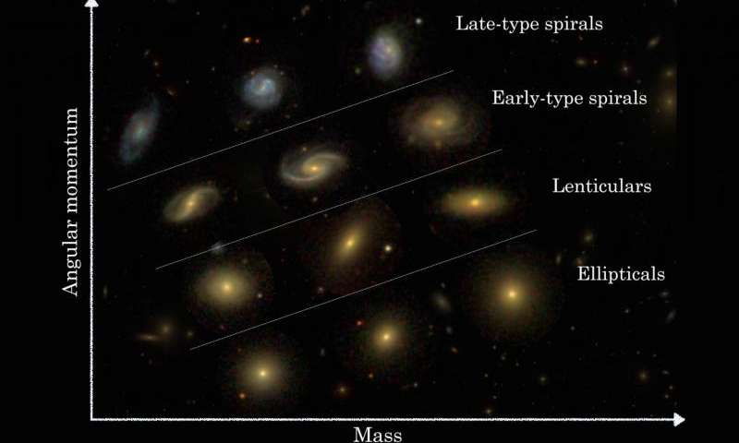
Galaxies

Slide 3
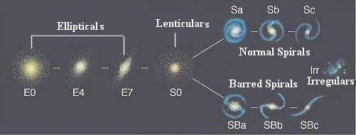
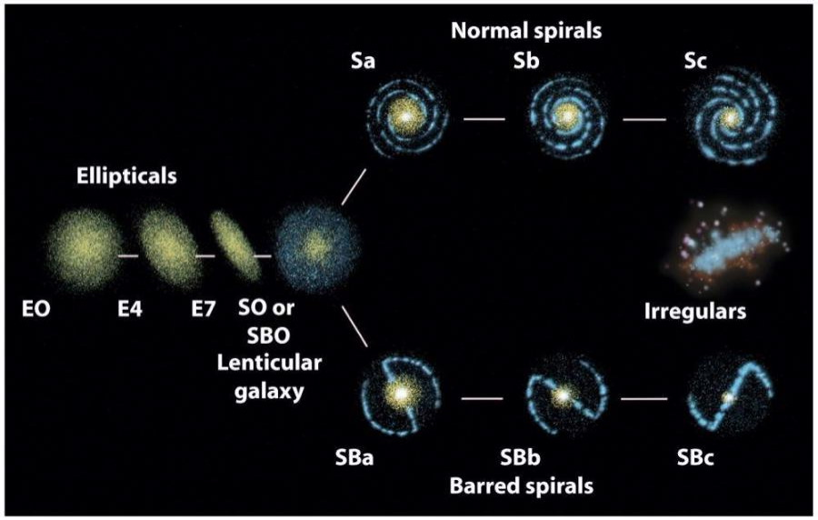
Galaxy evolution
Direction of evolution over time

Slide 4
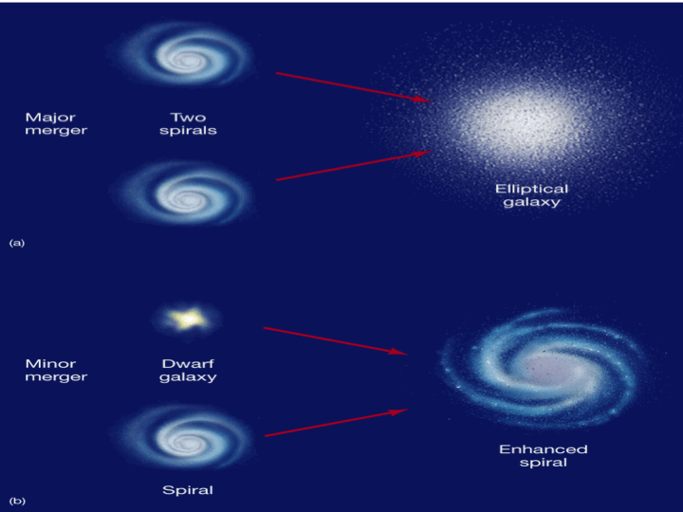
Collisions of galaxies possibilities

Slide 5
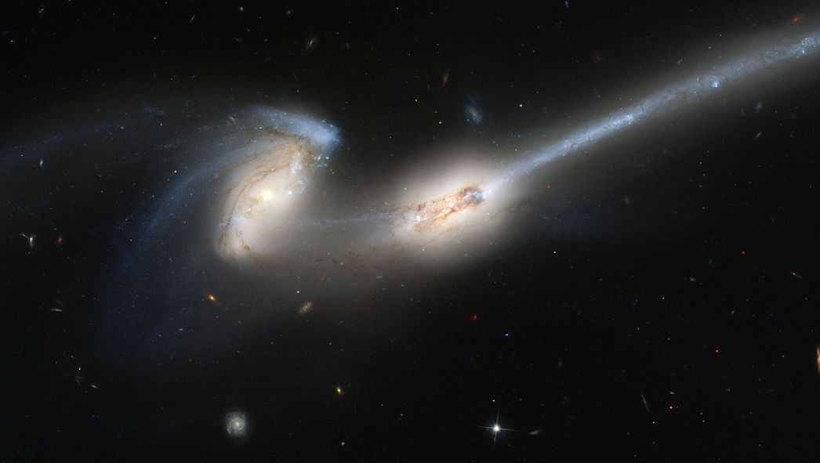
Collisions of galaxies

Slide 6
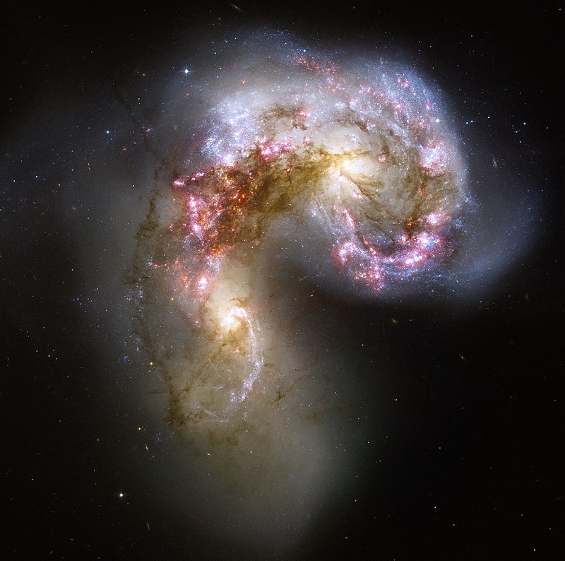
Collisions of galaxies

Slide 7

Classification of Galaxies

Slide 8

A Journey to our Closest Galaxies
(starting with Solar system)

Slide 9
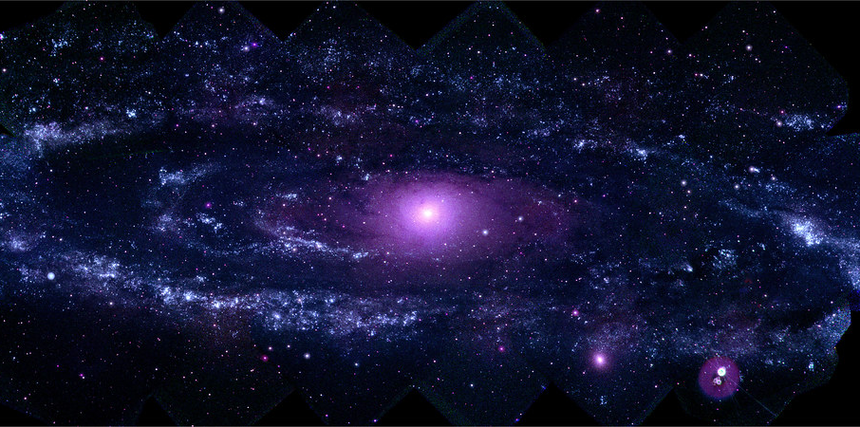
Any Questions?
Andromeda galaxy in UV light

